Slide 1
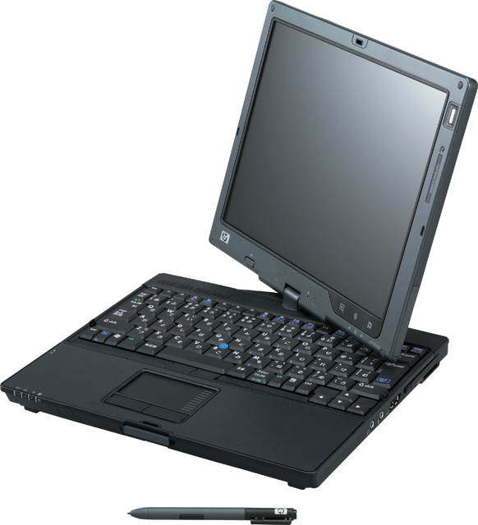
A Sketch-Based User Interface for Microsoft PowerPoint
Alice Zhu & Ellen Kephart
Advisors: Christine Alvarado & Sarah Harris
July 26, 2007
Harvey Mudd College, Computer Science Department
Project funded by: R.C Baker Foundation & Beckman Foundation
Notes:
ALICE
Hi, I’m ellen kephart
“ and my name is alice zhu” we are working on project –name-
ALICE PAGE
Mention advisors

Slide 2
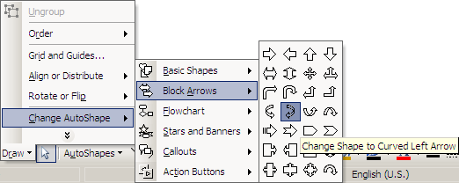
Project Goals
Pen-and-paper metaphor!
Learn about users
Notes:
ELLEN
HOOK : something that sucks about powerpoint, we can redesign powerpoint to make it better… menus bad!
Imagine a situation – stting outside with tablet pc makin ur presentation --- arrows you have to tap on. And draw another you have to do it again
Our project is to prevent that.
We had two main goals: 1)
Wanted to create an interface that took advantage of stylus and was designed for stylus using metaphor of pen sketching paper instead of powerpoint metaphor = Collage metaphor? (picking up objects – text boxes, shapes, etc – from a “pile” of menus / buttons and placing them on the slide
2)
Wanted to see how users reacted and what was most natural, efficient, and intuitive :
“contribute to the body of stylus research”

Slide 3
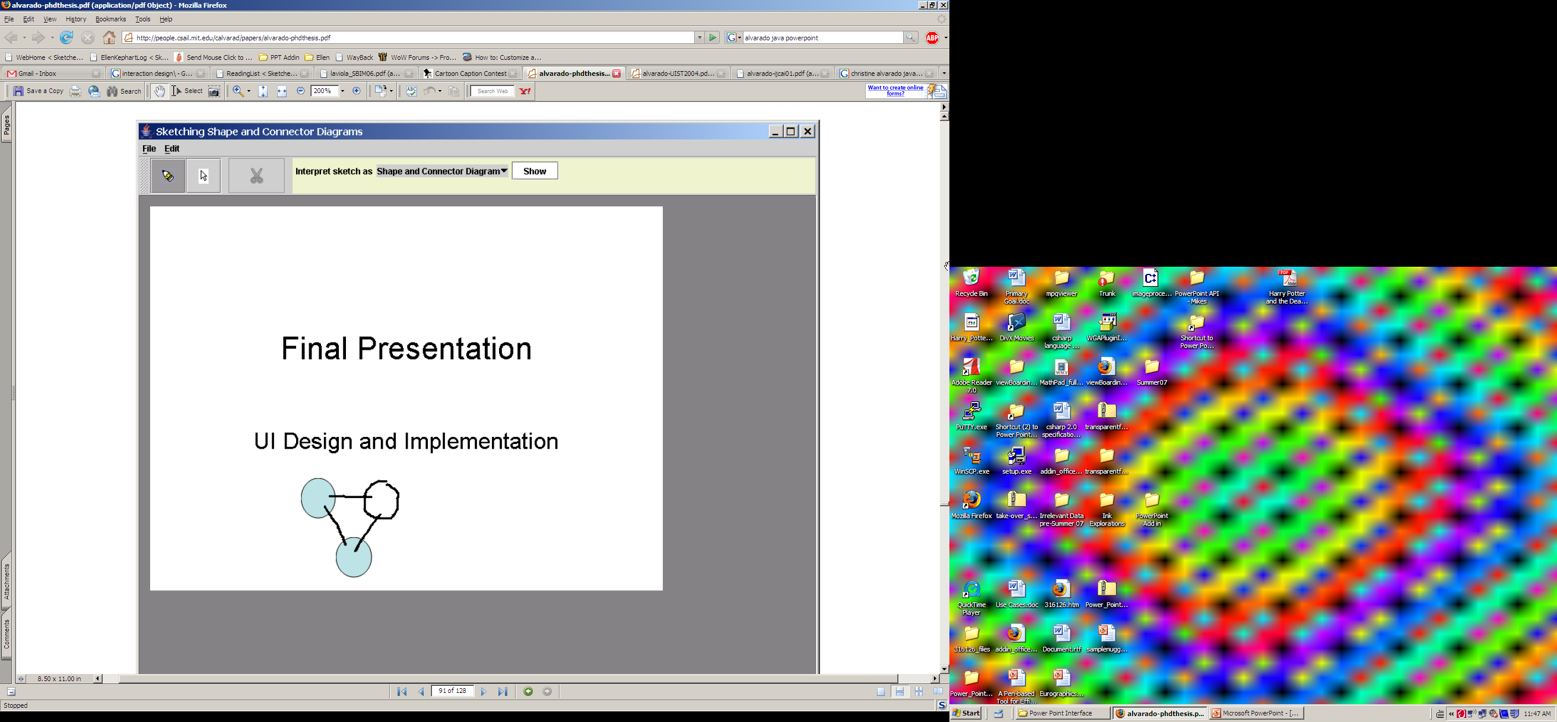
Related Work
Java Sketch Recognition (Alvarado)
Microsoft OneNote
Notes:
ELLEN
“There have been other studies performed which explore sketching as a method of user input .
Christine Alvarado’s paper Sketch Recognition User Interfaces: Guidelines for Design and Development
included a description of a program in which users could sketch diagrams which would be translated onto powerpoint slides… image in program would be synchronized with that of powerpoint
(cons: not an internal powerpoint addin, specialized to relationship diagrams only as opposed to general powerpoint interface)
Image = from http://people.csail.mit.edu/calvarad/papers/alvarado-aaai-fs.pdf Sketch Recognition User Interfaces: Guidelines for Design and Development
by
Christine J. Alvarado
“SketchREAD to build a sketch-based system for constructing relationship diagrams in PowerPoint. This tool recognizes naturally drawn diagrams and automatically imports them into PowerPoint. “ (89) – they switched between powerpoint and their java window
NO TEXT RECOGNITION
SketchREAD’s conclusions:
- wait for user cues (window focus switch or “show” button click) to recognize text * Restrict to a single domain (in this case circuit or relationship diagrams) – users don’t remember to switch
Pen –based editing in DISTINCT motion from sketching * Large buttons
OneNote – handwriting recognition, note-taking, has paper + pen metaphor

Slide 4
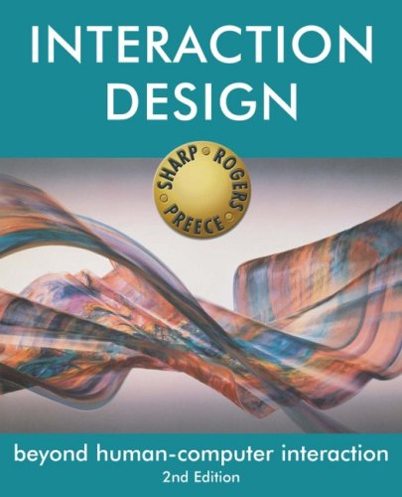
Initial Studies
Interaction Design (Preece, Rogers, & Sharp)
Videos of PowerPoint use
  Defied user expectations
Brainstorming
Notes:
ALICE
Watched videos of people using PowerPoint to create slides for intro CS lessons
- many “error” actions are from expecting program to behave in some way which it doesn’t (ie having to reselect which shape you want to add every time you add one – users quickly learn to copy paste (which to do quickly needs keyboard )
-- when adding text, will delete and retype several words to fix typo at beginning instead of navigating back – much less efficient if had had stylus as writing is by hand
-- uses keyboard shortcuts for many common tasks (copypasta etc) – when doing less often things eg Changing fill color, will use menu – which takes time
Read Interaction Design (Preece, Rogers, Sharp) – to gain a basic understanding of how to design user interfaces and conduct studies of human / computer interaction through these interfaces
Brainstormed what we should put on their: basic features : we are users too!
Resources:
http://www.amazon.com/Interaction-Design-Beyond-Human-Computer/dp/0470018666/ref=pd_bbs_sr_1/105-6708267-7012456?ie=UTF8&s=books&qid=1185389045&sr=8-1 ← image of Interaction Design

Slide 5
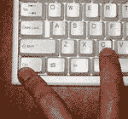
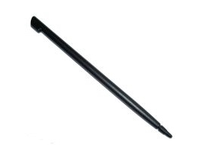
Human Interface Concerns
Gestures instead of shortcuts
Mimic writing on paper
Sketching
Notes:
Issues stylus users have with regular interface:
Menus are hard
Buttons too small
‘Some of the aspects of the interface we hoped to create;
We also hoped to verify these aspects were an improvement for stylus users and find out what other improvements could be made”
Recreate or utilize some built in PowerPoint features, such as copy, paste, undo, etc; all use gesture
The common tasks that people memorize the shortcuts for are the ideal ones to be targeted by gestures because people can memorize the gestures by using them just as they memorize the shortcuts
Less common tasks are not suitable to be gesturized because they will just have to look up the gesture every time and we won’t save on effort
Add in some new stuff, optimized for stylus, such as text entry, editing, and alternative recognition results
Let them sketch shapes instead of picking them from a menu

Slide 6
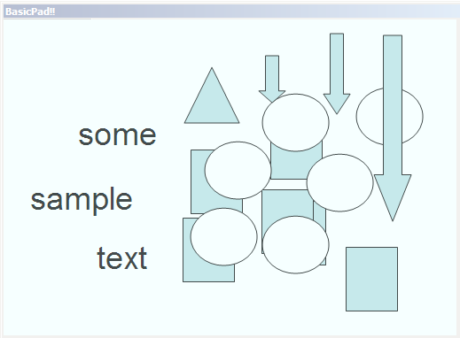

Initial Interface
Input Methods:
  Gestures
  Sketch
  Text
  Buttons
Notes:
What did we get out of these concerns – how did we make the interface
Ways for input : gestures / sketch / text / (additional buttons)
Crappy text recognition

Slide 7
User Studies
Moving objects
Gesture X | Click and Drag ✓
Text recognition
No Alternative X | Alternative ✓
Recognition result
At gesture X | At stroke location ✓
Feedback
Very little X | Feedback box ✓
Made a mistake
No undo X | Undo / redo ✓
Add shape
Default size X | Stroke size ✓
......
Informal user studies
Feedback
Undo
Consistency with PowerPoint
Text editing
Notes:
ALIKCE
es
Feedback
Undo
Right - click
---
What do they do right ? What is good for stylus???
What did they like about our current interface?
And what do we need to improve
(shows the before and after of our project, obvious to see what we improved and added)

Slide 8
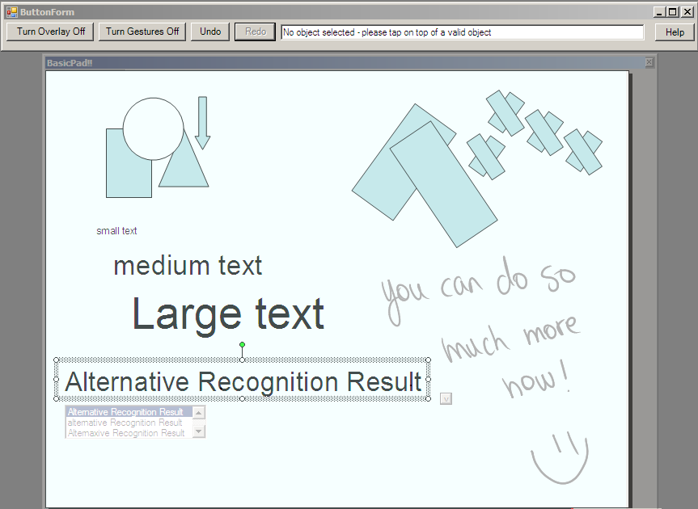
Current Interface
Overlay / gesture toggle
Sketch / gesture
Text mode
Button toolbar
Basic
Initial
Design
User
Studies
Notes:
ELLEN
New fuller featured overlay
- native – like shape editing
- lots of gestures to copy paste select
Text entry : proper size, alternative results, and gestures to edit add remove letters
feedback
Buttons – not too many – large for easy clicking – the features needing reliability eg undo, toggle overlay

Slide 9
Implementation Details
C#
PowerPoint COM Add-Ins
Tablet PC SDK
PowerPoint
Button Toolbar
User
PowerPoint
Controller
Ink
Input
Notes:
ELLEN
Access
We wrote a power point controller

Slide 10
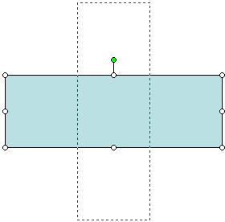
Implementation Issues
Constraints due to existing codebase
Interface decisions we made based on implementation issues
  Overlay toggle vs. native shape manipulation
  Alternate interactions
Notes:
ALICE
What prevented us from doing everything we wanted to do
Restrictions: PowerPoint built in system does not support some of the things we want to do – rotate a shape, the appearance changed, but the actual shape is still there
Different ways for letting the user do the same thing.

Slide 11
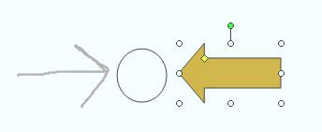

Technical Details
Tricky Features
  Alternative text
  Undo / Redo
  Rotate / Resize
User Results
Notes:
ALICE
Advanced features? (in terms of implementation, not in terms of … users)
- alternative text
- undo / redo
-

Slide 12
Where we are…
General idea → proof of concept
Many interesting features, but still buggy
More ideas, but insufficient technology
Guided by user input
Notes:
ELLEN
Framework insufficient for complete implementation
Restricted by PowerPoint, lack of gestures, etc
most

Slide 13
Future Study
Modeless text
General sketch recognition
Eraser for strokes and objects
More intuitive gestures
More user studies!
Notes:
ELLEN
We used built in microsoft recognizer
It’s good but not perfect.
If we had a perfect recognizer –
Modeless – recognize text
General shape recognizer
More intuitive shortcuts
Erase things from powerpoint
These are cool things that we have thought of, but really we will need to study users to see if that’s what they want, and see what other features they want.
Annoying features vs no features?

Slide 14

Questions?

